Slide 1
Low Cost Crowd Counting using Audio Tones
Pravein Govindan Kannan¹, Seshadri Padmanabha Venkatagiri¹, Mun Choon Chan¹, Akhihebbal L. Ananda¹ and Li-Shiuan Peh²
¹School of Computing,
National University of Singapore
²Computer Science and Artificial Intelligence Laboratory,
Massachusetts Institute of Technology
Notes:
OM NAMO GANAPATHAYEN NAMAHA

Slide 2
Outline
Why Crowd Counting?
Why Audio Tones?
Our System
Some Measurements
Evaluation

Slide 3
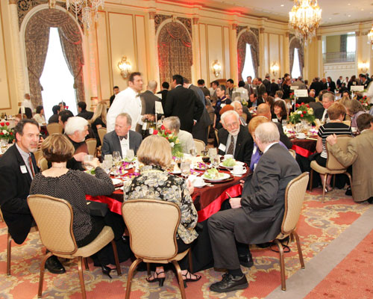
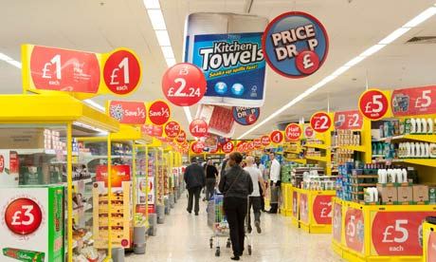
Why Crowd Counting?
Event Planning⁴
Proximity Marketing⁵

Slide 4
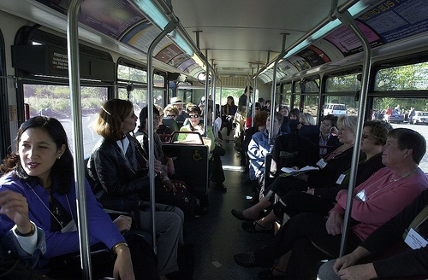
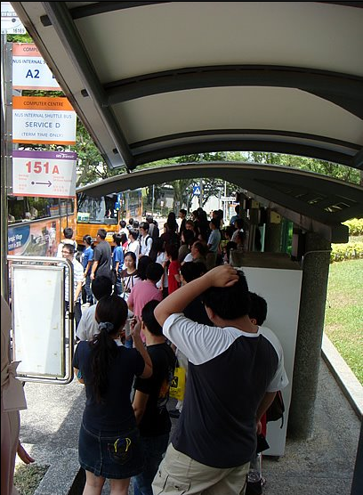
Why Crowd Counting?
Public/Private Commutation Services⁷
Public Transport Shelters⁶

Slide 5
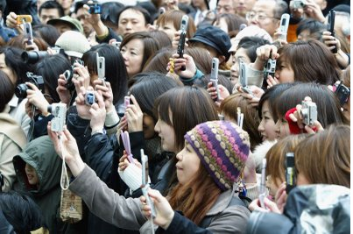
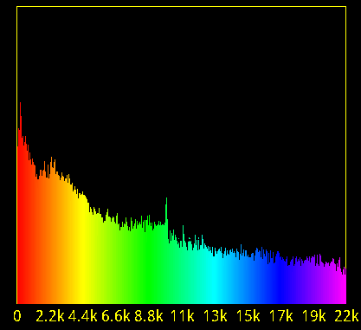
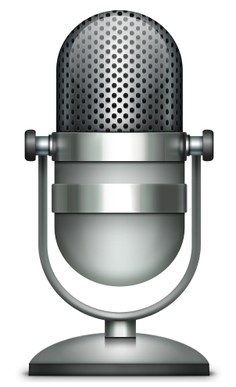
Crowd Counting Using Audio Tones
Crowd Counting
Ubiquity of smart phones¹
Microphone/Speaker as communication devices^{2,3}
Audio tones for communication

Slide 6
Outline
Why Crowd Counting?
Why Audio Tones?
Our System
Some Measurements
Evaluation

Slide 7
Why Audio Tones?
No Special Hardware: Speakers and Microphones are available in almost all mobile devices.
Power: Consumes less power than existing technologies such WiFi and 3G
Scalable: Can propagate multi-hop. Difficult to achieve with RFID
Anonymous: Unlike 3G, WiFi and Bluetooth, this does not disclose the smartphone’s identity

Slide 8
Outline
Why Crowd Counting?
Why Audio Tones?
Our System
Some Measurements
Evaluation

Slide 9
Our proposal based on Audio Tones…
Requires NO infrastructure
Reports upto 90% accurate count
Consumes at least 80% less power than WiFi and 3G
Can count upto 900 devices

Slide 10
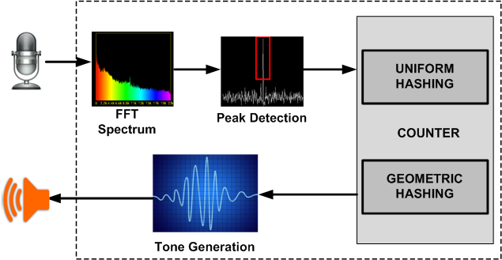
System

Slide 11
Uniform Hashing
Frequency
Set
Round 1
Round 2
Round 3
F₁
F₁
F₂
F₁
F₂
F₃
F₁
F₂
F₃
F₄
F₂
F₁
F₂
F₃
F₁
F₂
F₃
F₄
F₁
F₂
F₃
F₄
F₃
F₂
F₃
F₄
F₁
F₂
F₃
F₄
F₁
F₂
F₃
F₄
F₄
F₃
F₄
F₂
F₃
F₄
F₁
F₂
F₃
F₄
F₅
F₆
S
Notes:
Notice that in each round each node can send out unique frequency. Multihop frequency transmission ensures redundancy

Slide 12
Uniform Hashing
If frequency F_{i} is received by a phone, bit (i – 1) in the bitmap is 1, and 0 otherwise. For the previous example, bitmap is:
1
1
1
1
Bit 3
Bit 2
Bit 1
Bit 0, LSB
Estimated Count = Number of ones in the bitmap

Slide 13
Uniform Hashing
Number of nodes that can be counted scales linearly with frequencies available
Over-counts in the presence of ambient noise
Under-counts if two or more nodes pick the same frequency

Slide 14
Geometric Hashing
Frequency Set
PERFORM MULTIPLE ROUNDS SIMILAR TO UNIFORM HASHING
F₁
F₂
F₃
F₄
F₅
NOTE: Only 3 frequencies are used for 6 nodes
F₆
S
Notes:
½ phones are likely to map to F_1, ¼ to second and 1/8 to the third. Therefore, we need only 3 frequencies to represent 6 phones

Slide 15
Geometric Hashing
For the previous example, bitmap is:
0
1
1
Bit 2
Bit 1
Bit 0, LSB
Find the rightmost zero, R.
R = 2
Estimated Count is 1.2897 * 2^{E(R)} [From FLAJOLET et al. JCSS’1985. Used for duplicate-insensitive counting database records], where E(R) is expected value of R
Estimated Count = 5.156
But, E[R] has high variance, We use multiple simultaneous counting processes to improve accuracy
Notes:
Its unbiased estimate. It has very high bit rate. Using single estimate could have high variance. To address this, we should have many estimates.

Slide 16
Geometric Hashing
Frequency Set
Counting Process 1, R₁ = 2
F₁
F₂
F₃
Counting Process 2, R₂ = 3
F₄
F₅
F₆
S
E[R] = (R₁ + R₂)/2 = 2.5, Estimated Count = 7.3
Notes:
We divide the freq set into multiple subsets in order to perform multiple estimation in parallel. Note that it is possible with GH since n freq can support upto 2^n devices

Slide 17
Geometric Hashing
Duplicate Insensitive
Scales logarithmically with frequencies. n frequencies can count 2^{n}
Utilizes multiple simultaneous estimations to increase accuracy

Slide 18
Outline
Why Crowd Counting?
Why Audio Tones?
Our System
Some Measurements
Evaluation

Slide 19
Measurement and Evaluation: Tools
Hardware | 20 Google Nexus S, 5 Galaxy Nexus 1 HTC Desire, 1 HTC Desire HD 1 Samsung Galaxy S
Software | PowerTutor android app for power measurement Audacity for Tone generation Sound Meter android app for ambient noise measurement Audalyzer app as the basis for our application
Notes:
Nexus S for measurement. System evaluation we have used other phones.

Slide 20
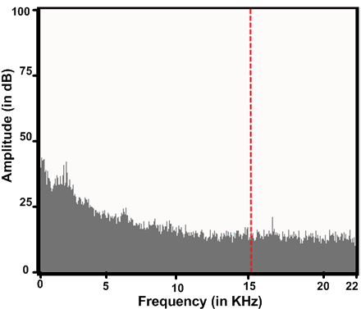
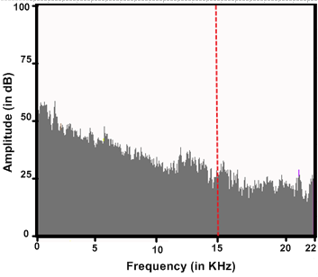
Measurement: Indoor Ambient Noise
Indoor (quiet):
42dB (<15KHz), 22dB (>15KHz)
Indoor (canteen):
59dB (<15KHz), 35dB (>15KHz)

Slide 21
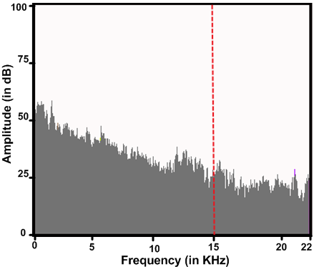
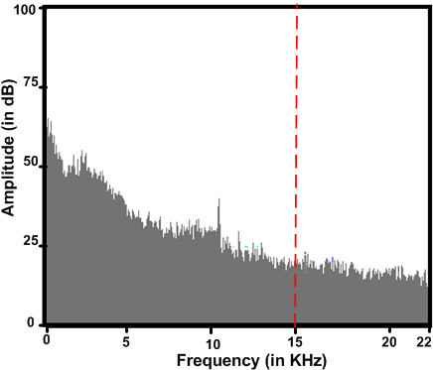
Measurement: Outdoor Ambient Noise
Outdoor (Bus Stop):
61dB (<15KHz), 32dB (>15KHz)
Outdoor (Bus):
63dB (<15KHz), 24dB (>15KHz)

Slide 22
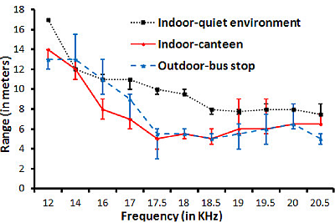
Measurement: Range Vs Frequency

Slide 23
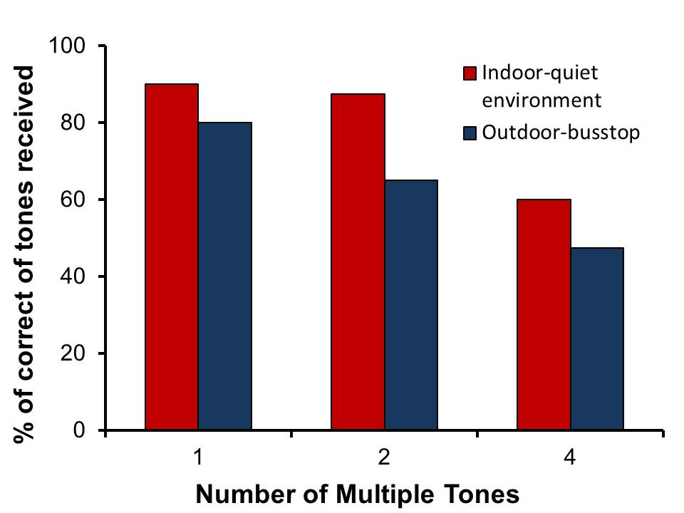
Measurement: Multiple Tones

Slide 24
Prioritization of frequency transmissions
Multiple simultaneous transmission is limited due to noise produced by speaker
Prioritizing newer and locally generated frequencies in the emitter list reduced latency
Frequencies are not accepted into the count unless they appear a fixed number of time

Slide 25
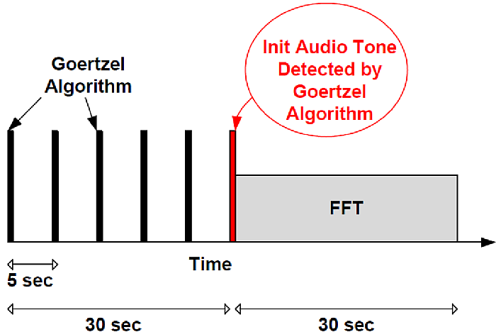
Conserve Energy By Duty-cycling
Illustration of Counting Process Activity Over Time
Notes:
Goertzel detects a specific frequency.

Slide 26
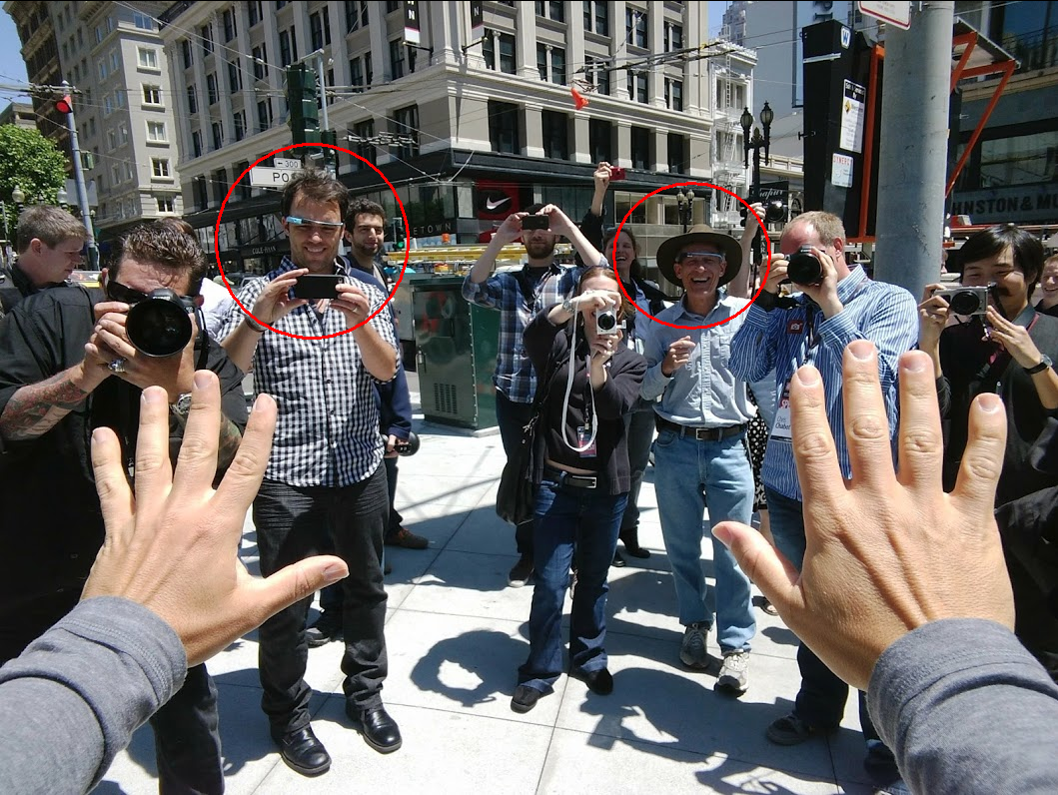
Impact of Clothing
People may carry smartphones in pockets
Clothing could reduce detection range by 50%
Our Apps can run on wearable devices like Google Glass. This could help overcome impact of clothing

Slide 27
Outline
Why Crowd Counting?
Why Audio Tones?
Our System
Some Measurements
Evaluation

Slide 28
Evaluation: Parameters
Parameter | Value
Frequency Range | 15KHz – 20KHz
Guard Band | 50Hz
Tone Width | 400ms
Tones per Transmission | 2
Stabilization time for Count | 5s – 8s
Number of Estimates | 10
Amplitude | 80% Volume

Slide 29
Evaluation Metrics
Accuracy
Latency of counting process.
Power consumption

Slide 30
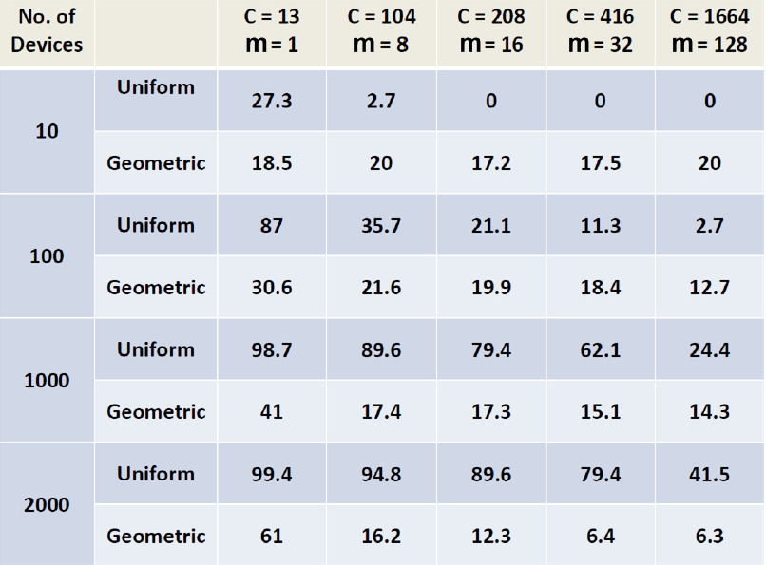
Evaluation: Accuracy In Simulated Scenario With No Ambient Noise
Can count up to 8096 devices
Error is between 12% and 21%. WE USE m = 10

Slide 31
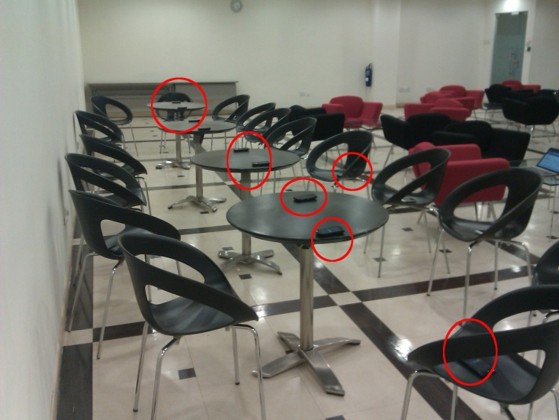
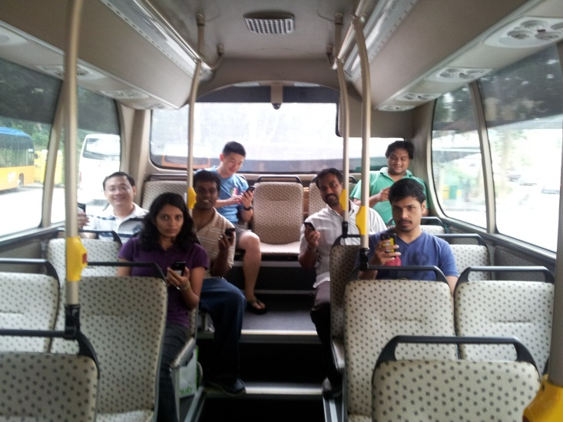
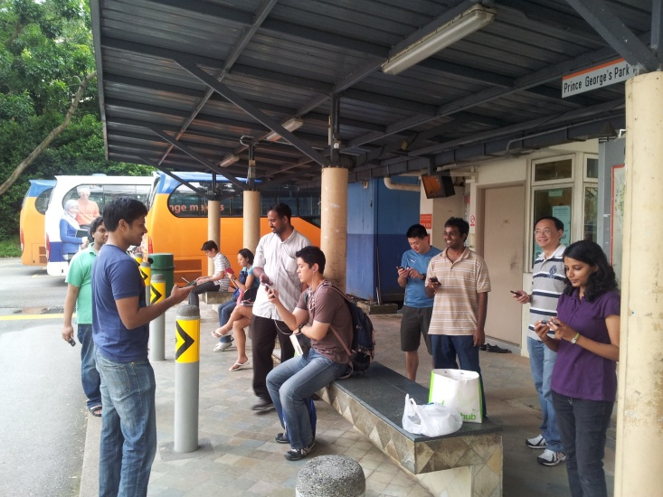
Evaluation: Scenario For Accuracy Experiment
Indoor
Outdoor (Bus)
Outdoor (Bus Stop)

Slide 32
Evaluation: Accuracy
Indoor
Outdoor (Bus)
Outdoor (Bus Stop)

Slide 33
Evaluation: Accuracy
On average, Geometric hashing accuracy is better than Uniform hashing approach.
In some cases, Geometric hashing error is higher than Uniform hashing. The error remains around the 20% limit which is seen in the simulation.
The only case wherein Geometric hashing error is significantly above 20% limit is because, when the evaluation runs were made for this data point, some of the phones malfunctioned. We retain the result for completeness.

Slide 34
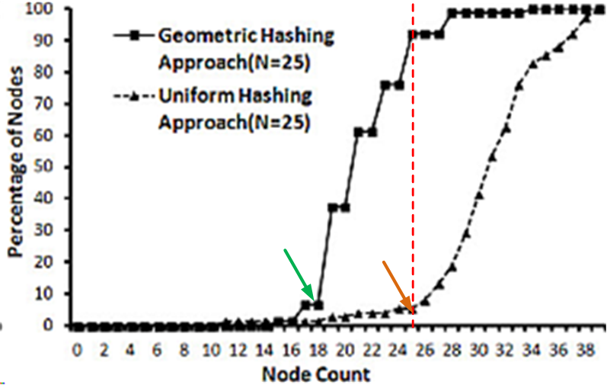
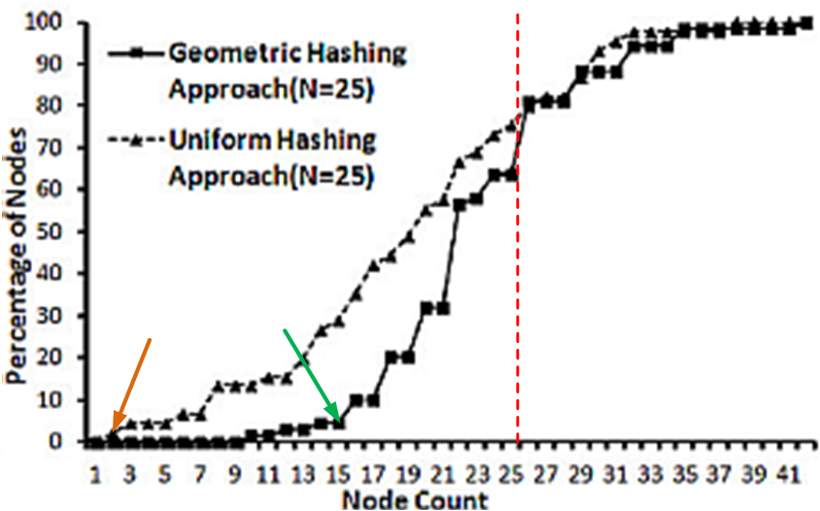
Evaluation: Count Distribution for (N=25)
Indoor
Outdoor (Bus)
Geometric Hashing: 80% nodes count between 16 and 31
Uniform Hashing: 30% below 16, 50% between 16 and 31
Deviation in count is higher due to relatively harsher environment
Geometric Hashing: 80% of nodes count between 18 and 27
Uniform Hashing: 80% nodes count between 26 and 36

Slide 35
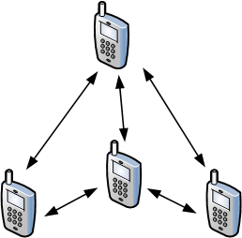
Evaluation: Single Hop Latency Experiment
Number of Nodes | 2 | 4 | 6 | 8 | 10 | 12 | 15
Latency (in seconds) | 0.43 | 6.1 | 7.4 | 8.0 | 7.8 | 8.1 | 7.5
All nodes communicate one-hop
Frequency Division Multiplexing prevents contention
Latency remains constant although nodes increase
Single Hop: Scenario

Slide 36
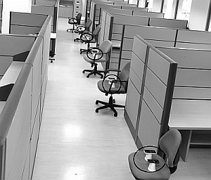
Evaluation: Multi-Hop Latency Experiment
Number of Nodes | 2x2 | 2x3 | 2x4 | 2x5 | 2x6
Number of Hops | 1 | 2 | 3 | 4 | 5
Latency (in seconds) | 6.1 | 11.0 | 17.0 | 19.7 | 20.2
Increase the number of nodes and number of hops.
Objective is to bring out the multi-hop feature. The effect of hop count on the counting process is also explored.
Multiple Hop: Scenario
Notes:
Straight line, each chair has 2 phones. Phones are placed such that tones cannot be detected directly by nodes more than one hop away.

Slide 37
Evaluation: Results for Power Consumption
Settings | Power Consumption (in mW)
3G (ping every 10ms) | 952
WiFi (ping every 10ms) | 480
WiFi (ping every 100ms) | 422
WiFi (ping every 1s) | 65
WiFi (no activity) | 57
BENCHMARK
Notes:
Compare with existing technology. One could count using central server and 3g, or AP/WiFi. We try to see how our system fares in terms of energy efficiency compared to these options. We pick the most efficient approach for comparison for baseline which is wifi with no activity.

Slide 38
Evaluation: Results for Power Consumption
Settings | Power Consumption (in mW)
WiFi (no activity) | 57
Tone counting (FFT, continuously) | 88
Tone counting (FFT, every 350ms) | 73
Tone counting (FFT, every 600ms) | 40
Tone detection (Goertzel, every 1s) | 12
Tone detection (Goertzel, every 5s) | 1.1
Notes:
How often we run matters (every 2min)

Slide 39
Conclusion
We have developed two algorithms to which harness the potential of audio tones to perform crowd counting.
We have built an App that could be installed on any phone with Android operating system and evaluated it in real-life scenarios

Slide 40
Questions?

Slide 41
THANK YOU

Slide 42
References
http://statusmagonline.com/blackberry-and-globe-telecom-present-nicki-minaj/
http://eoc.du.ac.in/images/500px-Speaker_Icon_svgerer.gif
http://roadtointrospection.blogspot.sg/2012/06/10-reasons-your-microphone-is.html
http://www.southerncaliforniarestaurantwriters.net/assets/images/SCRW_banquet2.JPG
http://static.guim.co.uk/sys-images/Money/Pix/pictures/2012/3/16/1331903929152/Tesco-Extra-supermarket-a-007.jpg
http://keropokman.blogspot.sg/2008/05/oh-no-how-to-get-in-bus.html
http://www.flickr.com/photos/seattlemunicipalarchives/2851696370/in/faves-andersonleal/
https://plus.google.com/photos/111626127367496192147/albums/5745849874061604161/5745851316774497090
http://setiathome.ssl.berkeley.edu/plots/timeseries_ap_signal_63515286.jpg
http://689086740.rombla.com/images/bigstockphoto_Audio_Signal_1293091.jpg

Slide 43
Related Work
Application/Method | Passive Listening | Active Transmission
Environment or Traffic monitoring | NoiseTube, Ear-phone, NeriCell | -
Social context | CenceMe, SurroundSense, Neary | PeopleTones, MoVi
Activity and location tracking/inference | SoundSense, JigSaw, SpeakerSense, Darwin phones, TagSense | -
Data transmission | - | Naratte, Inc., Context-aware computing with sound
Ranging | - | BeepBeep, Centaur(2012)

Slide 44
Future Work
Low frequency melodies/chirps could be used to penetrate through clothing
Tone width could be used to perform another dimension of encoding
Introduce State/Context based Counting
Could be deployed on wearable devices like Google Glass

